Slide 1


School of Computer Science
University of Birmingham
MSc Project MSc Demonstration :
Implementation & Validation of the Ethereum JSON RPC API for ERC-20 Token Transaction Retrieval & Money Laundering Detection
Presented by :
Juilee Gund (2677497)
Under the Supervision of :
Dr. Pascal Berrang

Slide 2
01
02
03
Background & Problem
Aim & Objectives
Methodology
04
05
06
Analysis & Results
Conclusion
References

Slide 3

Blockchain Technology
Transaction Request
Block created representing the Transaction
Block sent to every node for Validation
Transaction completed
Block is added to existing Blockchain
Nodes receive rewards for PoW (Proof of Work)

Slide 4

ZETA
USDT
CVX
LEND
EURS
DAI
SHIB
POWER
BNT
PAY
USDC
ERC-20 Tokens
NEXO
OXT
SHIB
WTC
SAI
REN
Ethereum
WBTC
ENJ
PEPE
SNT

Slide 5
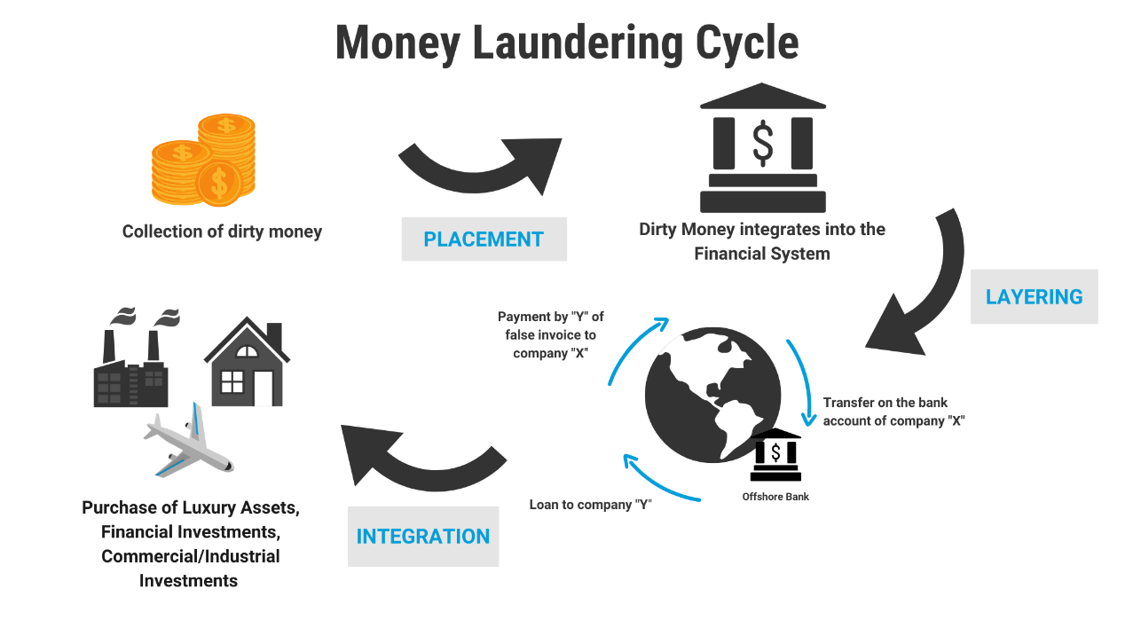
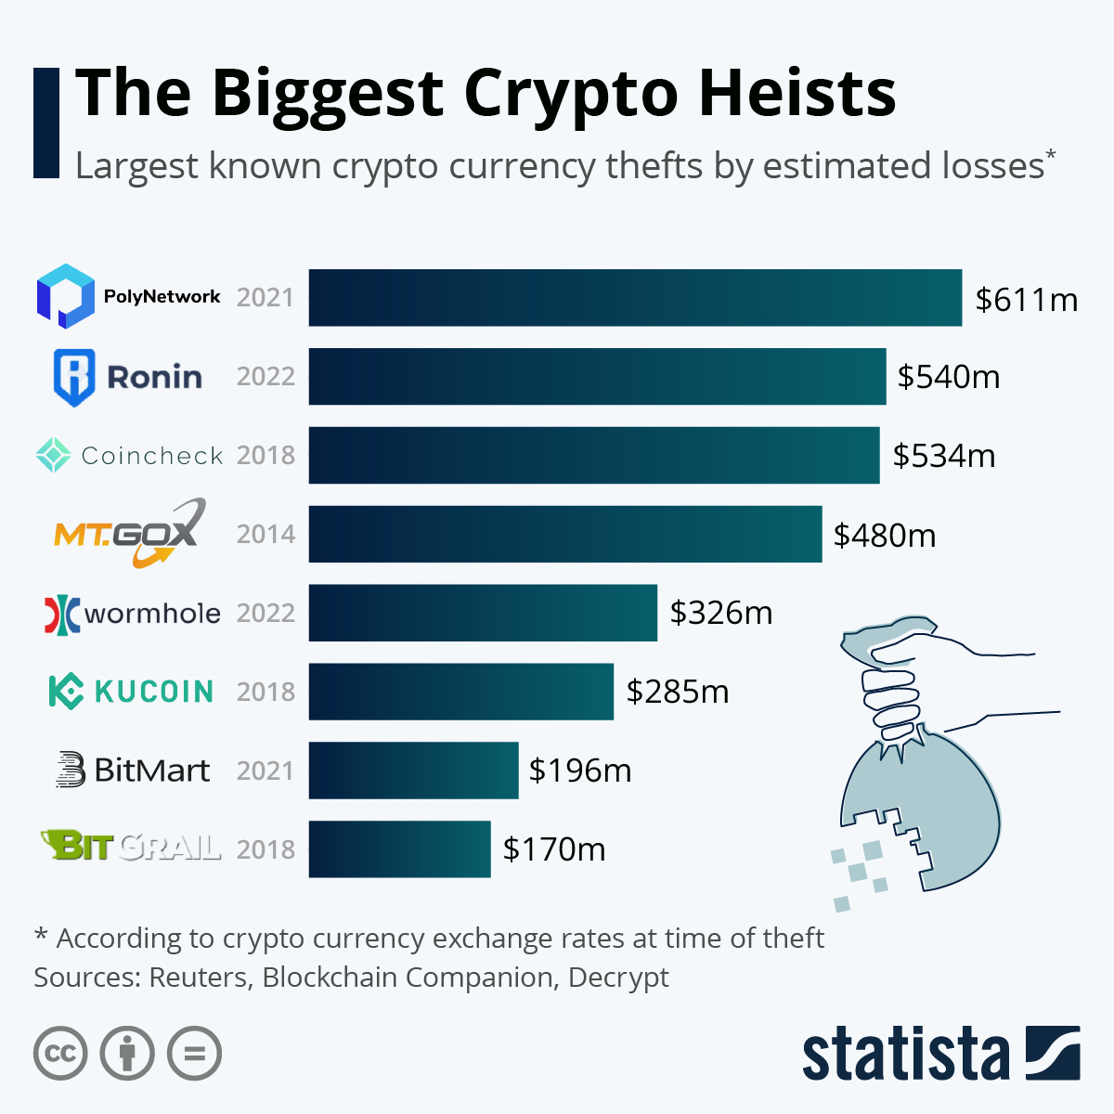
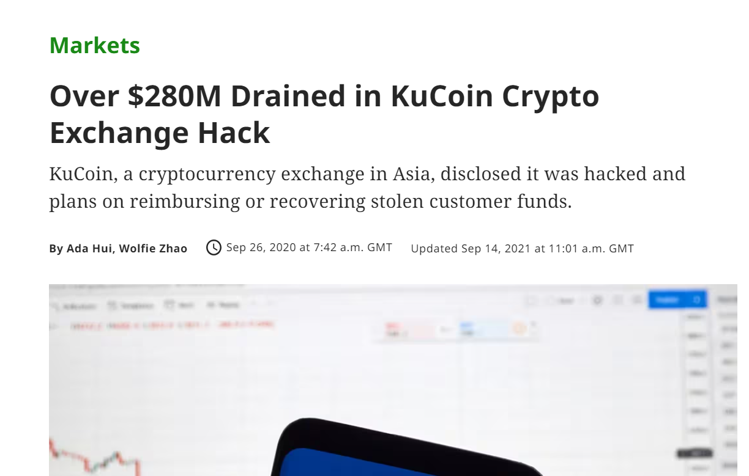
Money Laundering
Figure 2. KuCoin Crypto Exchange Hack [2]
Figure 1. Biggest Crypto Heists [1]
Figure 3. Money Laundering Cycle [3]

Slide 6
Aim
Objectives
6
The aim of this project is to implement Ethereum's JSON-RPC API methods & validate the retrieved ERC-20 token transaction logs. Additionally, analyse these transaction logs to identify patterns indicative of money laundering.
5
Determine token transfer movement
Identify suspicious transactions
Integrate Ethereum's JSON RPC API Methods
4
Illustrate transactional token transfer graph
Create a development environment
3
Validation of Results
2
1

Slide 7



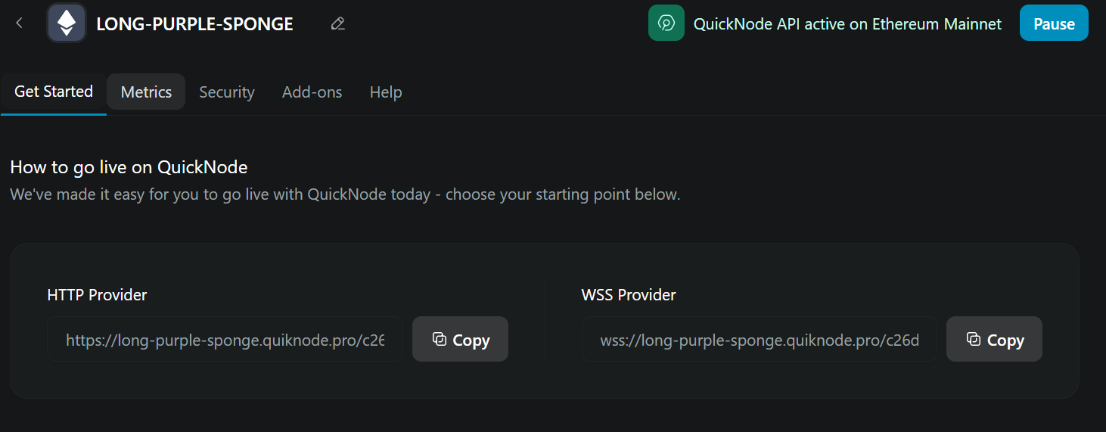
Methodology
Web3.py
Dash Cytoscape

Slide 8
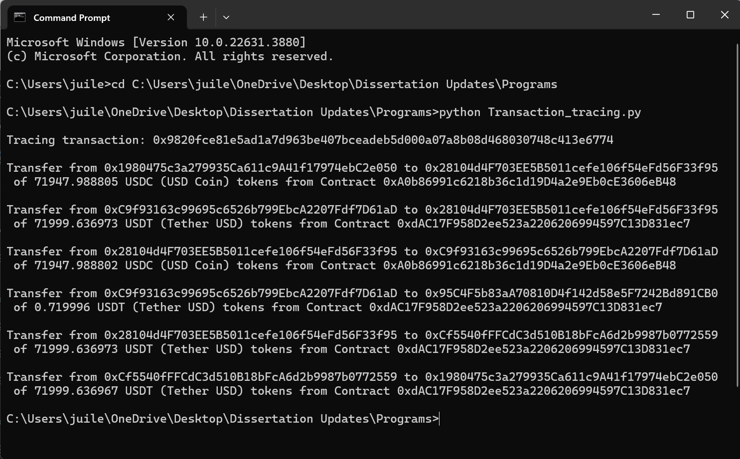
Analysis & Results
Transaction Hash
JSON RPC API methods eth_getTransactionByHash eth_getTransactionReceipt
eth_getLogs
Sender
Token Amount & Symbol
Contract Address
Receiver
Figure 4. ERC – 20 Token Transaction Logs

Slide 9
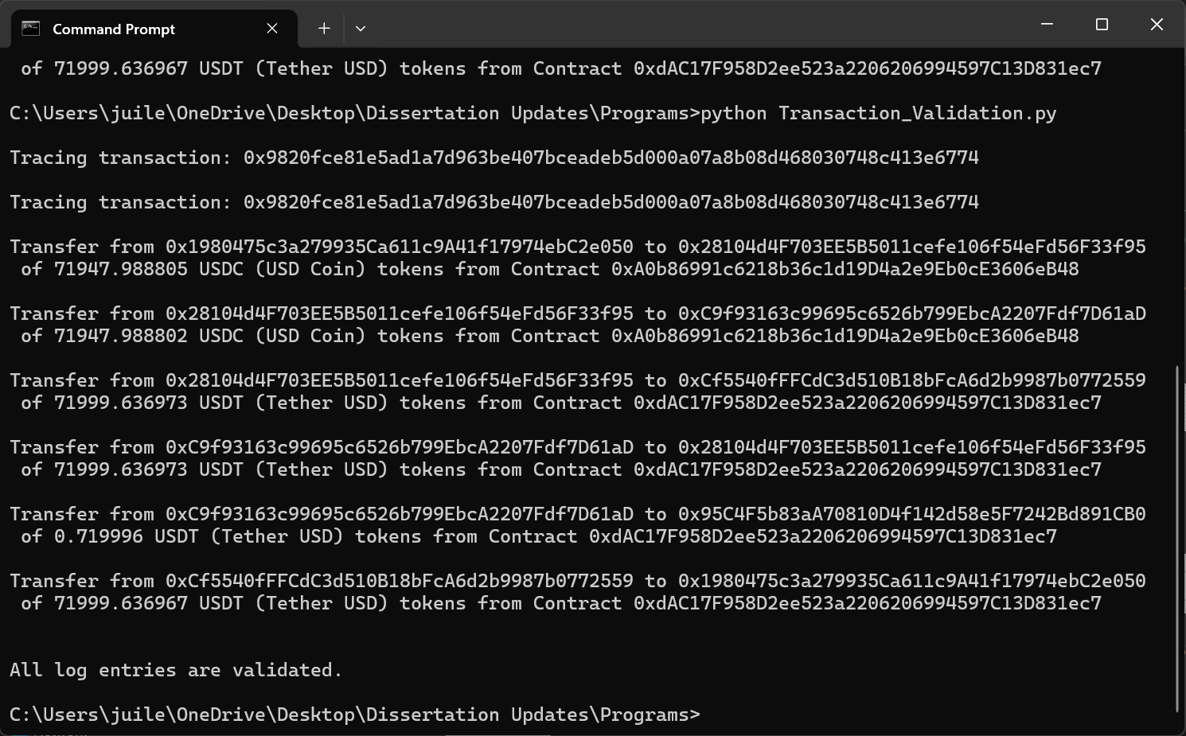
JSON RPC API methods eth_getTransactionByHash eth_getTransactionReceipt
eth_getLogs
Transactional Data
Validated
Figure 5. Validation of Token Transaction Logs

Slide 10
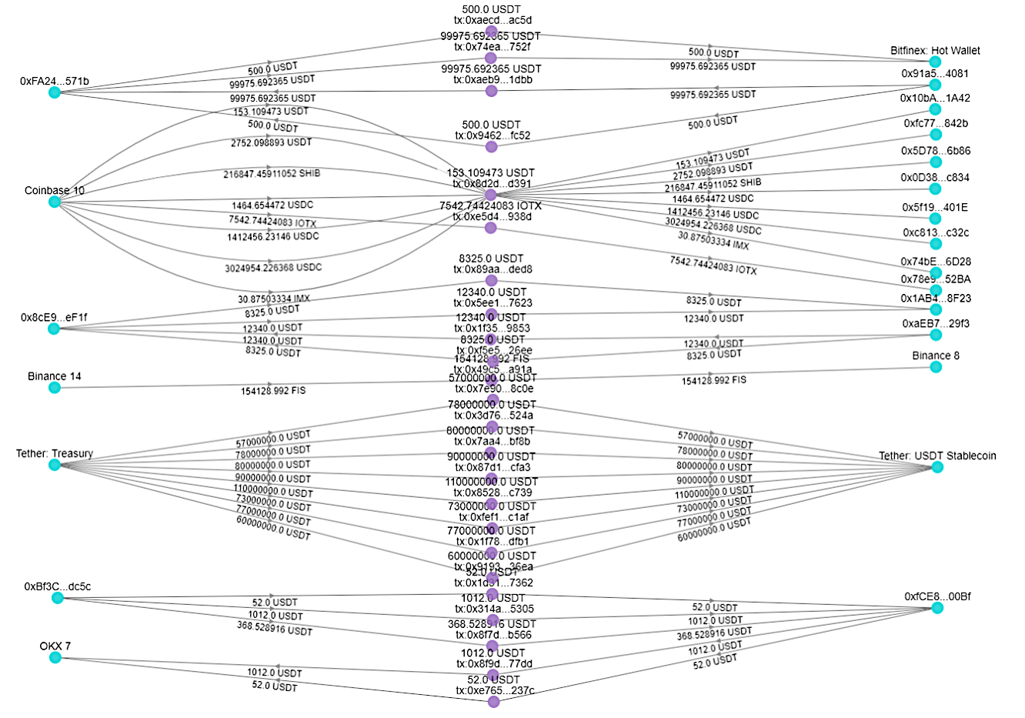
Transaction Hash
Sender
Receiver
Token Amount & Symbol
Figure 6. Token Transfer Graph

Slide 11
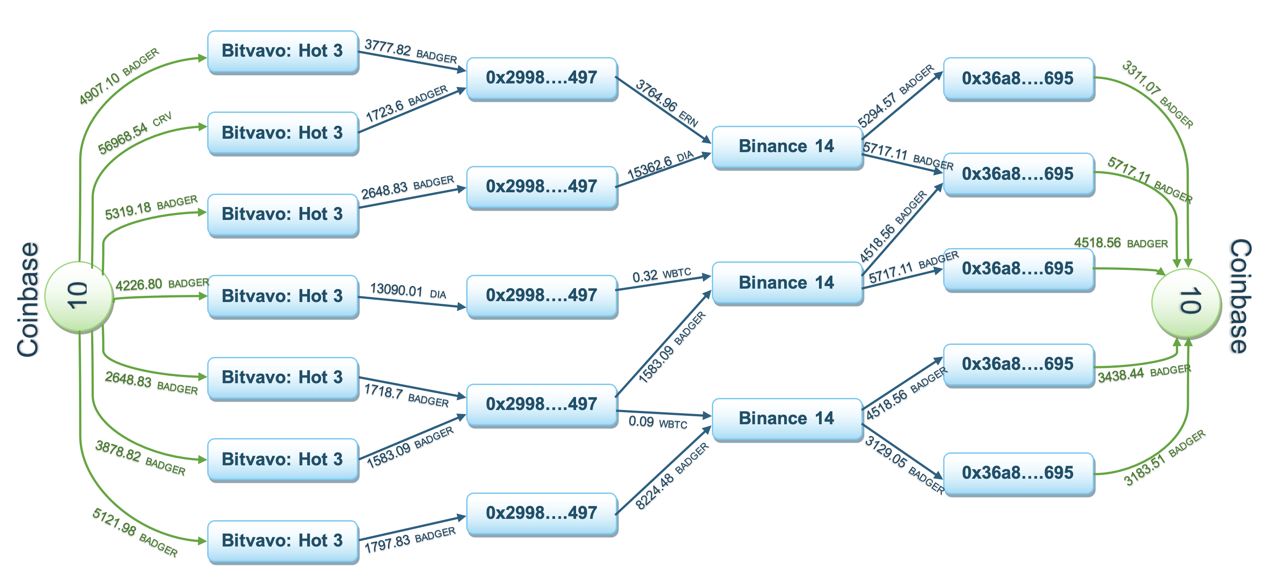
Figure 7. Suspicious Pattern Indication of Money Laundering

Slide 12
Conclusion
Successful implementation of Ethereum’s JSON RPC API methods for retrieving ERC-20 token transaction logs.
Validated retrieved data by combining custom node interaction with third-party validation.
Analyzed for potential money laundering patterns, offering valuable insights into blockchain transactions and their misuse.
Additionally, this work contributes to a broader research project focused on money laundering detection, offering practical insights for future developments in this area.

Slide 13
References
1. The Biggest Crypto Heist. May 2022. [Online]. [Assessed 22 07 2024] Available from: https://www.statista.com/chart/12707/largest-known-crypto-currency-thefts/
2. Crypto Exchange Hack. September 2020. [Online]. [Assessed 22 08 2024] Available from: https://www.coindesk.com/markets/2020/09/26/over-280m-drained-in-kucoin-crypto-exchange-hack/
3. Money Laundering Stages. [Online]. [Assessed 24 08 2024] Available from: https://www.unodc.org/unodc/en/money-laundering/overview.html
4. Yuan, Q., Huang, B., Zhang, J., Wu, J., Zhang, H. and Zhang, X. 2020 October. Detecting phishing scams on Ethereum based on transaction records. In 2020 IEEE international symposium on circuits and systems (ISCAS) (pp. 1-5). IEEE.
5. Shadrooh, S. and Nørvåg, K. 2024. SMoTeF: Smurf money laundering detection using temporal order and flow analysis. Applied Intelligence, pp.1-18.
6. Wu, J., Lin, D., Fu, Q., Yang, S., Chen, T., Zheng, Z. and Song, B. 2023. Towards Understanding Asset Flows in Crypto Money Laundering Through the Lenses of Ethereum Heists. IEEE Transactions on Information Forensics and Security.
7. Case Study: How We Track Crypto Money Laundering for Off-Chain Crime. September 2023. [Online]. [Assessed 22 06 2024] Available from: https://www.chainalysis.com/blog/japan- cryptocurrency-money-laundering-case-study
8. Di Angelo, M. and Salzer, G. 2020, August. Tokens, types, and standards: identification and utilization in Ethereum. In 2020 IEEE International Conference on Decentralized Applications and Infrastructures (DAPPS) (pp. 1-10). IEEE.
9. Wronka, C. 2022. “Cyber-laundering”: the change of money laundering in the digital age. Journal of Money Laundering Control, 25(2), pp.330-344.
10. Teichmann, F. 2020. Recent trends in money laundering. Crime, Law and Social Change, 73, pp.237-247.
11. Aimar, D. 2023. Extraction, indexing and analysis of Ethereum smart contracts data (Doctoral dissertation, Politecnico di Torino).
12. Chen, H., Pendleton, M., Njilla, L. and Xu, S. 2020. A survey on ethereum systems security: Vulnerabilities, attacks, and defenses. ACM Computing Surveys (CSUR), 53(3), pp.1-43.
13. Aimar, D. 2023. Extraction, indexing and analysis of Ethereum smart contracts data (Doctoral dissertation, Politecnico di Torino).

Slide 14
Thank You

